Slide 1
Inhalational anesthesia agent for anesthesia Bsc 2022/23

Slide 2
Nitrous oxide(N2O), chloroform, and ether were the first universally accepted general anesthetics. Inhalation agents currently in widespread use in clinical anesthesiology including N2O halothane, isoflurane, desflurane, and sevoflurane
WHAT IS THE EFFECTS OF INHALATIONAL ANESTHESIA?

Slide 3
Inhalational anaesthetics produce loss of consciousness, but may have other effects including analgesia (N20) or Musel relaxation(isoflurane) They are presented as liquefied gases under pressure or as volatile liquids

Slide 4
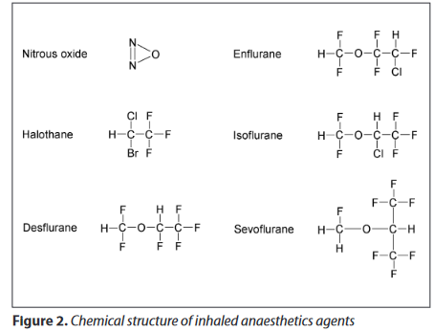

Slide 5
Pharmacokinetics of Inhalation Anesthetics
The mechanism of action of inhalation anesthetics not clear involving numerous membrane proteins and ion channels,
Directly activate GABAa receptors throughout brain →decrease neuronal activity.
To producing their ultimate effect depends on attainment of a therapeutic tissue concentration CNS.

Slide 6
MAC (minimum alveolar concentration) of an inhaled anesthetic is the alveolar concentration that prevents movement in 50% of patients in response to a standardized stimulus (eg,surgical incision).
MAC is a useful measure because it mirrors brain partial pressure, allows comparisons of potency between agents, and provides a standard for experimental evaluations

Slide 7
Inhalational agent | MAC%
halothane | 0.75
isoflurain | 1.17
enflurane | 1.68
desflurane | 6.60
sevoflurain | 1.80
N2O | 105

Slide 8
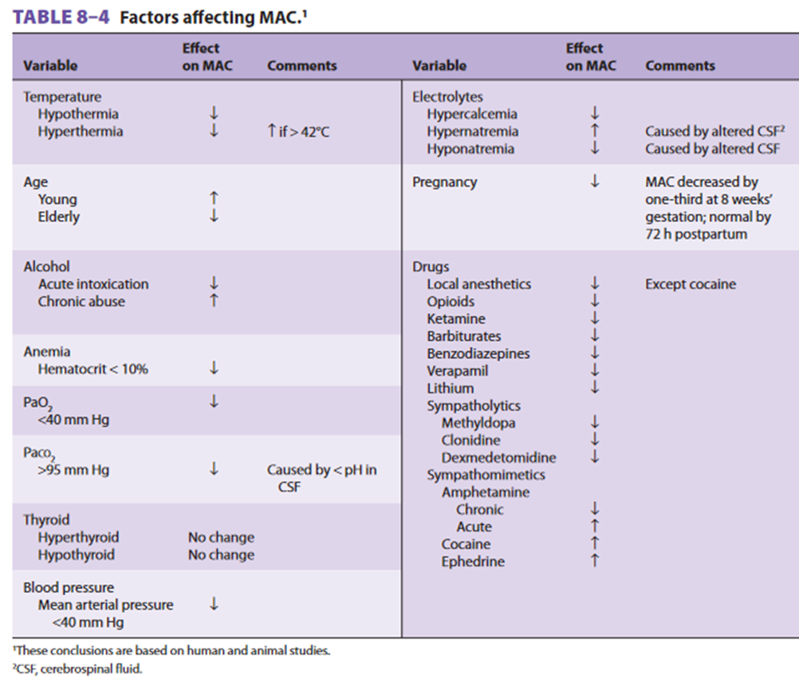

Slide 9
The Ideal Inhaled Anesthetic Agent
Biochemical Properties
• low MAC
• Low blood:gas partition coefficient(PC)
• Not metabolised
• Non-toxic
• Not epileptogenic
• analgesic properties & Only affects the CNS
Physical Properties
• Stable to light and heat
• Inert when in contact with metal, rubber and soda lime
• Preservative-free
• Not flammable &
• Pleasant odor, Cheap.
• Not a greenhouse gas

Slide 10
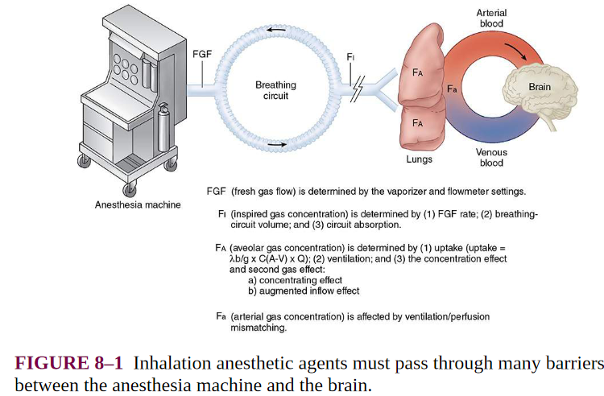

Slide 11
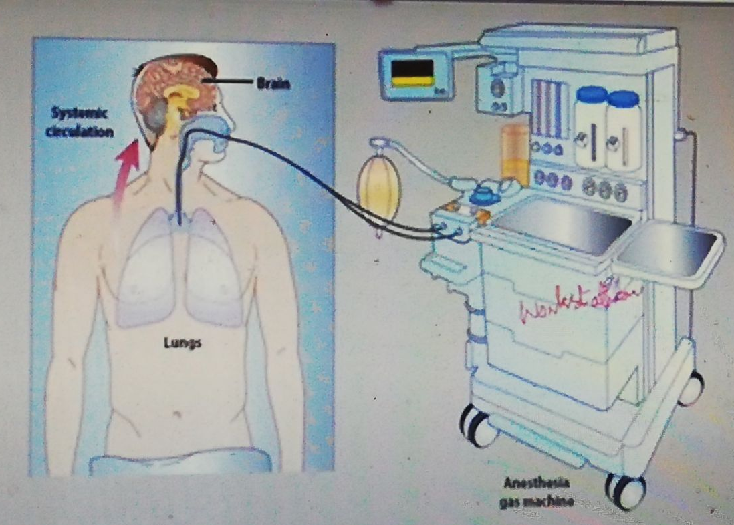

Slide 12
The anesthetic passes across the alveolar–capillary membrane and dissolves in pulmonary blood according to the partial pressure of the gas and its blood solubility. It is further diluted and travels via bulk blood flow throughout the vascular tree. The CNS tissues of the vessel-rich group are referred to as tissues of desired effect.The muscle& fat groups comprise the tissues of accumulation.

Slide 13
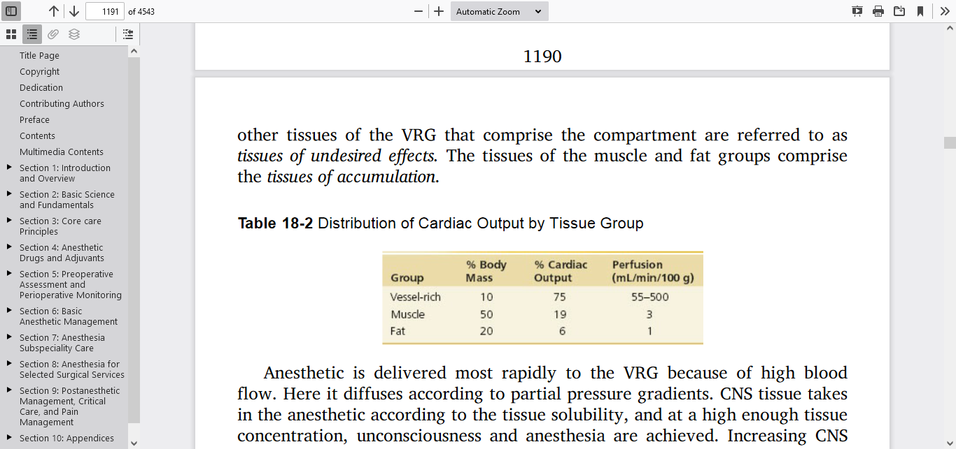

Slide 14
Uptake and Distribution
A simple, common way to assess anesthetic uptake is to follow the ratio of fractional concentration of alveolar anesthetic to inspired anesthetic. (FA/FI)

Slide 15
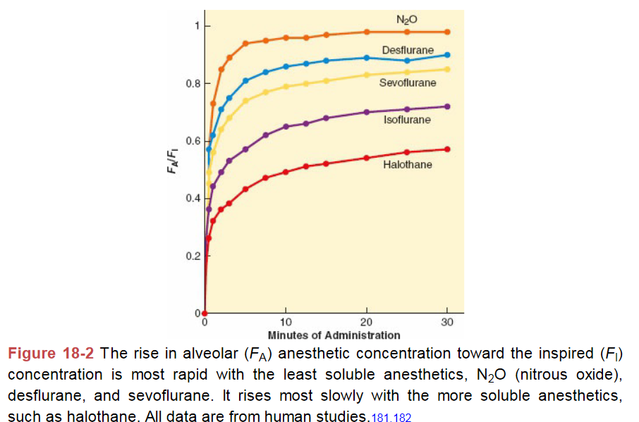

Slide 16
If there were no uptake of anesthetic agent by the body, the alveolar gas concentration (FA) would rapidly approach the inspired gas concentration (FI).b/c anesthetic agents are taken up by the pulmonary circulation during induction, alveolar concentrations lag behind inspired concentrations (FA/FI <1.0).

Slide 17
The greater the uptake of anesthetic agent, the greater the difference between inspired and alveolar concentrations, and the slower the rate of induction.

Slide 18
Three factors affect anesthetic uptake:
solubility in the blood,
alveolar blood flow
The difference in partial pressure between alveolar gas and venous blood

Slide 19
Blood:Gas Partition Coefficient
The blood:gas partition coefficient(PC) is defined as the ratio of the amount of anaesthetic in blood and gas when the two phases are of equal volume and pressure and in equilibrium at 37°C.
Agents with a low blood:gas partition coefficient exert a high partial pressure and will, therefore, produce a more rapid onset and offset of action..

Slide 20
A blood:gas PC of 0.5 means that the concentration of inhalant in the blood is half that present in the alveolar gas when the partial pressure of the anesthetic is identical at both sites.
PC in an inhalation anesthetic is most commonly used to refer to its solubility in a given solvent (e.g., oil, blood etc.).

Slide 21
Alveolar anesthetic concentration(FA) primarily depends on
a. Inspired concentration
b. Alveolar ventilation (MV &FRC)
c. Solubility of inhalant in blood:tissues
d. Cardiac output
e. Tissue capacity and blood flow to the tissues

Slide 22
A high cardiac output will tend to maintain a concentration gradient between the alveolus and the pulmonary blood so that PA rises slowly. Conversely, a low cardiac output favours a more rapid equilibration and so onset of anesthesia will also be more rapid.

Slide 23
Vapor pressure is pressure exerted by the molecule of the vapor phase at equilibrium of molecule moving in and out of liquid phase.
Vapor pressure dependent on temperature and physical characteristics of liquid, independent of atmospherics pressure . ↑ temp. ↑vapor pressure
Vapor pressure is a measure of the agent ability to evaporate(volatility).the greater is the vapor pressure ,the greater the concentration of inhalant delivery to the patient and environment.

Slide 24
Boiling point: temperature at which vapor pressure equal atmospheric pressure.
solubility in blood only exert a low partial pressure in blood, even when present in large amounts It is the partial pressure of the agent in the blood that affect

Slide 25
Many of the factors that speed induction also speed recovery:
Elimination of rebreathing,
↓ FI &high fresh gas flows,
low anesthetic-circuit volume,
low absorption by the anesthetic circuit,
decreased solubility, high cerebral blood flow, and increased ventilation

Slide 26
Alveolar concentration of inhalant reflects the amount in the brain
The higher the vaporizer setting, the higher the inspired concentration (or partial pressure) of the inhalant by the patient, which results in the higher alveolar concentration
At equilibrium, the CNS partial pressure of inhaled anesthetics equals their arterial partial pressure, which in turn equals their alveolar partial pressure

Slide 27
Blood/tissue (fat) solubility
The less soluble the anesthetic gas in fat, the lower the uptake in fat tissue.
o In short anesthetics may not be important, but for long anesthetics, it affects recovery. in a fat persons , recovery will be slow, even with agents with a low blood/gas solubility.

Slide 28
Medical condition that alter PC
Lower blood gas PC:
Hemodiluation,obesity,hypoalbumenia and starvation
High blood gas PC:
Hypothyroidism ,post prandial and child vs adult

Slide 29
The Concentration Effect
The concentration effect is an observed phenomenon that describes the disproportionate rate of rise of the alveolar fraction compared with the inspired fraction when high concentrations of N2O are inspired

Slide 30
The concentration effect refers to the principle that the concentration of inspired anesthetic gas influences both
the alveolar concentration that may be attained and
the rate at which that concentration may be attained.

Slide 31
The second gas effect
It occurs when a soluble first gas such as nitrous oxide is delivered in high inspired concentrations. Alveolar-capillary uptake of the first gas increases the alveolar concentrations of other gases present, accelerating their uptake.

Slide 32
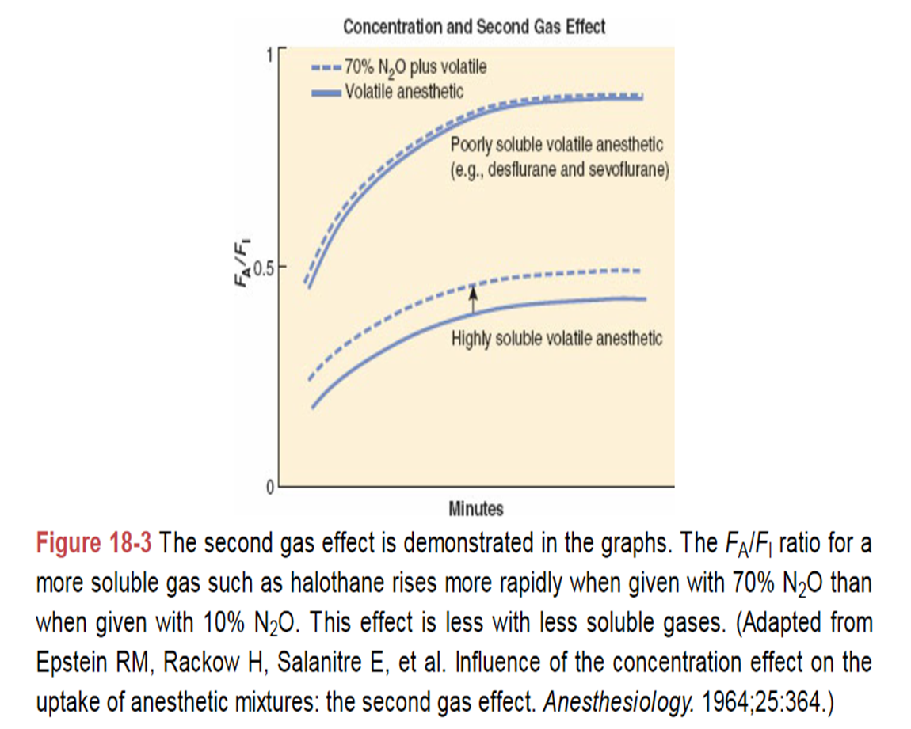

Slide 33
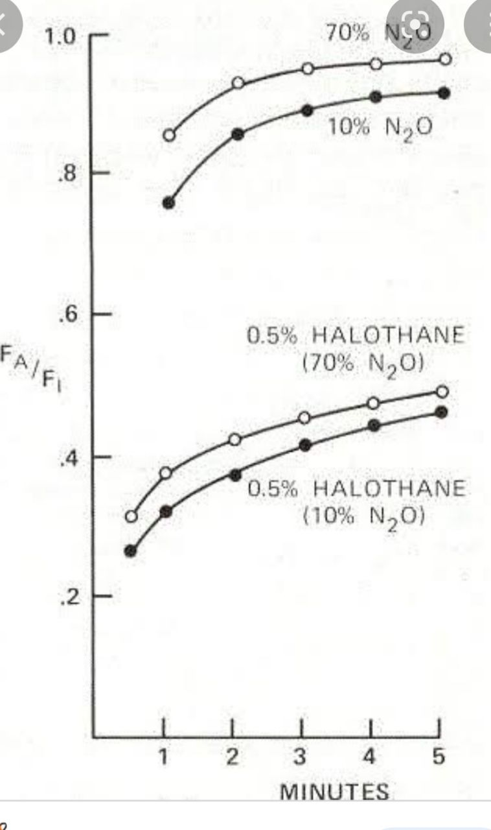

Slide 34
The Fink effect, also known as "diffusion anoxia", "diffusion hypoxia", or the “third gas effect", is a factor that influences the pO2 within the pulmonary alveoli. Which is the reverse of second gas effects.

Slide 35
Diffusion Hypoxia
At the end of anesthesia when N2O/O2 is replaced by air (N2/O2) the reverse of the second gas effect is seen. The volume of N2O entering the alveolus will be more than the volume of N2 entering the pulmonary capillaries, resulting in a dilution of all alveolar gases followed by diffusional hypoxia

Slide 36
The inspired concentration and the blood: gas solubility of an inhaled anesthetic are the major determinants of the speed of induction. Solubility alone determines the rate of elimination.

Slide 37
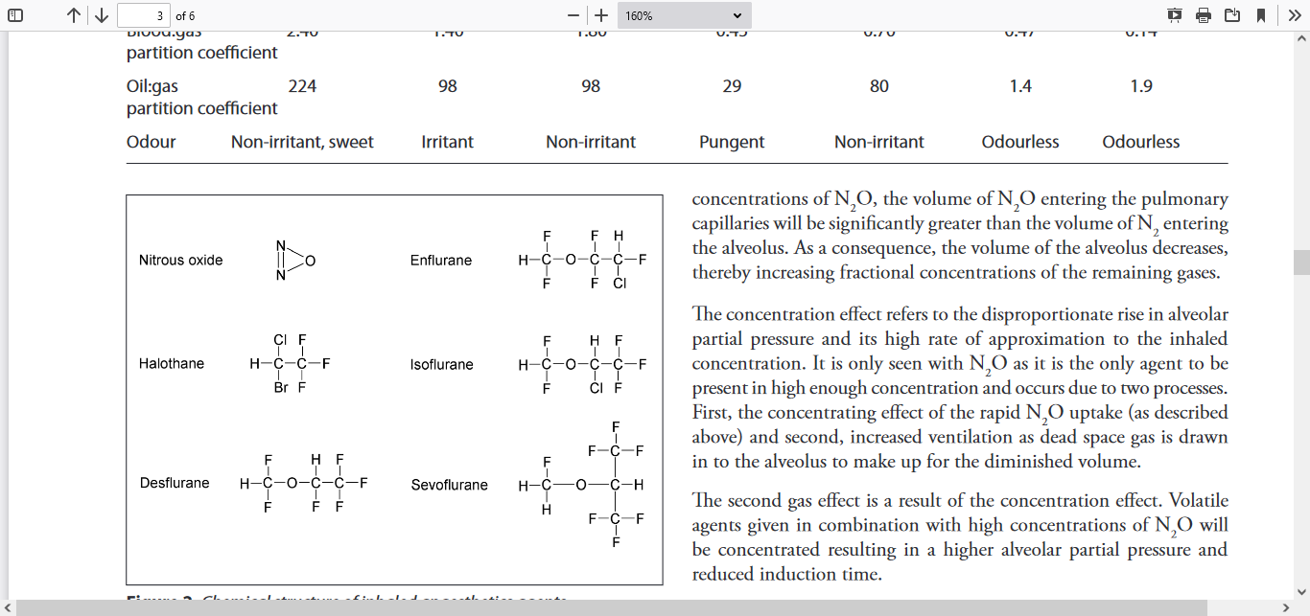
Metabolism
Halogen ions are released following metabolism by hepatic cytochrome p450 enzymes and may cause hepatic or renal damage. The C-F bond is relatively stable and only minimally metabolized, whereas C-Cl, C-Br and C-H bonds is easier to metabolism

Slide 38
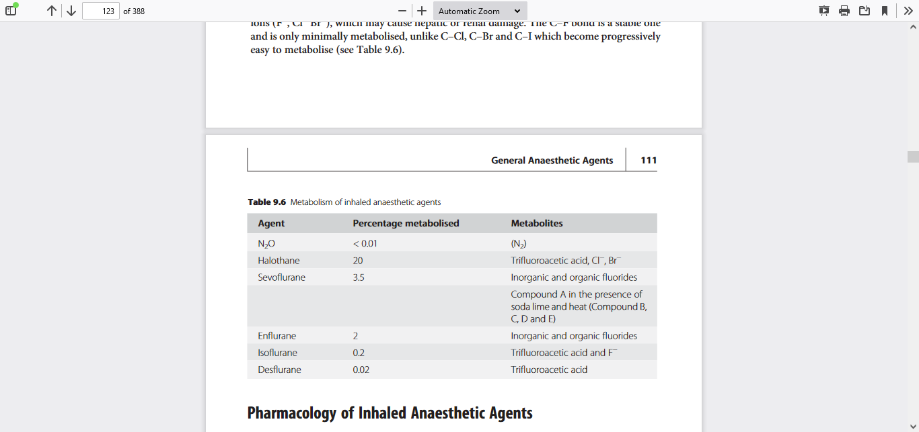

Slide 39
Inhalational anesthetics are all non ionized and have low molecular weights. This allows them to diffuse rapidly without the need for facilitated diffusion or active transport from bloodstream to tissues

Slide 40
Recovery from anesthesia depends on lowering the concentration of anesthetic in brain tissue. Anesthetics can be eliminated by biotransformation, transcutaneous loss or exhalation.

Slide 41
In summery Uptake and distribution
1.Transfer from inspired air to alveoli
Inspired gas consentration,alveolie ventilation and characteristics of anesthesia circuit
2.Transfer from alveoli to arterial blood
Blood gas PC,cardiac output and alveoli to venous pressure difference
3.Transfer from arterial blood to tissue
Tissue/blood PC,tissue blood flow and arterial to tissue pressure difference

Slide 42
MAC is equivalent of a median effective concentration EC50

Slide 43
NITROUS OXIDE (N2O)
It Has high MAC and commonly used in combination with other inhalational agent.
It is manufactured by heating ammonium nitrate to 250ºC,
NH4NO3 → N2O + 2H2O
N2O is stored as a liquid in French blue cylinders with a gauge pressure of 51bar at 20ºC. The gauge pressure does not give an indication of cylinder content until all the remaining N2O is in the gaseous phase.

Slide 44
N2O is colorless and essentially odorless.
Despite is potent analgesic property its use in theatre is decreasing due to its potential to cause nausea and vomiting and environmental pollution

Slide 45
Effects
Respiratory
• mild ↓ in TV but ↑ in RR.
Cardiovascular
• Mild direct myocardial depression which is compensated by sympathetic activity but if CHF ↓ CO
CNS ↑ CBF and CMRO2 consumption renal system ↓ RBF, GFR&UO,
Hepatic blood flow ↓

Slide 46
Neuromuscular
Like other inhalation agents, nitrous oxide does not provide significant muscle relaxation. Gastrointestinal
Use of nitrous oxide in adults increases the risk of postoperative nausea and vomiting,

Slide 47
Hypoxic drive, the ventilatory response to arterial hypoxia markedly decrease
Diffusion hypoxia is likely when N2O is used due to the reverse of the concentration effect at the end of anesthesia. alter the immunological response to infection by affecting chemotaxis and motility of polymorphonuclear leukocytes

Slide 48
Entonox is a 50:50 mixture of N2O and O2. The two gases effectively dissolve into each other
Uses
Entonox is used commonly for analgesia during labour and other painful procedures.
When is N2O is contraindicated?

Slide 49
Examples of conditions in which nitrous oxide might be hazardous include venous or arterial air embolism, pneumothorax, acute intestinal obstruction with
bowel distention, intracranial air (pneumocephalus following Dural closure, pulmonary air cysts, intraocular air bubbles, and tympanic membrane grafting.

Slide 50
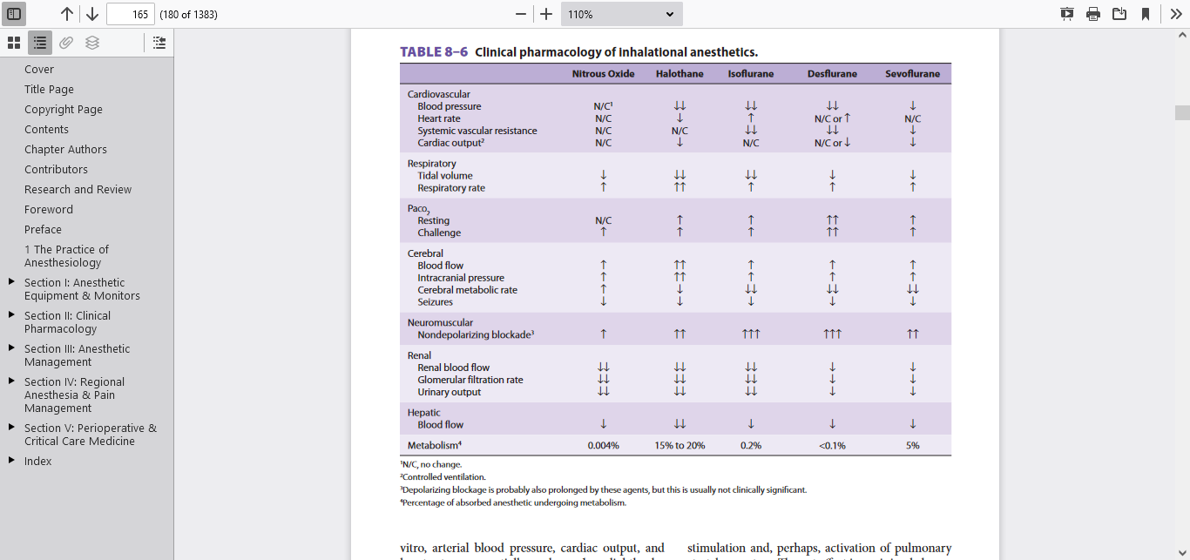

Slide 51
Halothane
Halothane is a halogenated alkane.
The carbon–fluoride bonds are responsible for its nonflammable and non explosive nature. Its MAC is 0.75
Halothane is unstable when exposed to light & heat. the bottle is amber-colored in order to decrease spontaneous oxidative decomposition , corrodes certain metals and dissolves into rubber. It is presented with 0.01% thymol to prevent liberation of free Br.

Slide 52
Effects
Respiratory
• MV ↓ due to ↓ TV tidal
response to hypoxia and hypercarbia are blunted.
• It has a sweet non-irritant odor and used for induction.
• It bronchodilator and is useful in asthmatic patient.
It attenuates airway reflexes and relaxes bronchial smooth muscle by inhibiting intracellular calcium mobilization.
It also depresses clearance of mucus from the respiratory tract (mucociliafunction), promoting postoperative hypoxia& atelectasis.

Slide 53
Cardiovascular
• ↓ HR produced by increased vagal tone, depressed Sino atrial and atrioventricular activity.
. Renal
Halothane reduces renal blood flow, glomerular filtration rate, and urinary
Output Preoperative hydration limits these changes

Slide 54
A dose-dependent decrease in arterial blood Pressure and HR because of direct myocardial depression and decrease in SVR.
If pt.given 2.0 MAC of halothane without intervention ,B/P and cardiac out decrease by 50%.
lowing of Sino atrial node conduction may result in a junction rhythm or bradycardia.

Slide 55
• it sensitizes the heart to catecholamines may lead to arrhythmias epinephrine above 1.5 mcg/kg should be avoided.
• Cerebral blood flow is increased more than any other volatile agent leading to significant ↑ ICP. However, cerebral oxygen requirements are reduced

Slide 56
The combination of halothane & aminophylline resulted in serious ventricular arrhythmias.

Slide 57
it is a trigger for malignant hyperthermia.
hepatic blood flow to decrease in proportion to the depression of cardiac output. Hepatic artery vasospasm has been reported during halothane anesthesia.

Slide 58
Metabolism
• 15 to 25% of halothan oxidized in the liver by a particular isozyme of CYP (2EI) to its
principal metabolite produce trifluoroacetic acid,Br- and Cl-. However, when the liver becomes hypoxic, reductive metabolism predominates, producing F-Toxicity
• Hepatic damage can take one of two forms:
• Reversible form - often subclinical and is associated with a rise in hepatic transaminases. This is probably due to hepatic hypoxia.

Slide 59
• Fulminant hepatic necrosis (‘halothane hepatitis’) – trifluoroacetyl chloride may behave as a hapten which binds to hepatic proteins and induces antibody formation. Diagnosis is by exclusion, and risk factors include: multiple exposures, obesity, middle age and female sex. Mortality is around 50-75%. The incidence in adults is 1 in 2500-35000.
• Halothane should be avoided if it has been given in the previous 3 months, if there is a past history of adverse reaction to halothane,or if there is pre-existing liver disease.

Slide 60
What do you think the contra indication for halothane ?

Slide 61
Contraindication
unexplained liver dysfunction following previous anesthetic exposure.
in patients with intracranial tumor.
Hypovolemic patients and some patients with severe reductions in left ventricular function. because of negative inotropic effects.
In patient low MAP
when exogenous epinephrine is in use or in patients with pheochromocytoma

Slide 62
ISOFLURANE
Isoflurane is a nonflammable volatile anesthetic with a pungent ethereal odor it is a structural isomer of enflurane. it usually used for maintenance of anesthesia b/C of its pungent smell not used for inhalational induction.

Slide 63
Effects
Respiratory
• Ventilation is depressed more than halothane, but less than enflurane.
Enflurane>isofloraine >halothane
• MV ↓ but RR and PaCo2 are ↑
can cause upper airway irritability and breath-holding However it cause some bronchodilation.

Slide 64
Cardiovascular • markedly ↓ SVR resulting in compensatory tachycardia.
small decrease in myocardial contractility. • It has been proposed that isoflurane may cause ‘coronary steal’if coronary perfusion is maintained, coronary steal does not occur. •have myocardial protective properties via its effects on ATP-dependent potassium channels.

Slide 65
Isoflurane dilates coronary arteries, but not nearly as potently as nitroglycerin or adenosine. Dilation of normal coronary arteries could theoretically divert blood away from fixed stenotic lesions.

Slide 66
Central nervous system • Of all the volatile agents, isoflurane produces the best balance of reduced cerebral oxygen requirement and minimal increase in CBF.
At concentrations greater than 1 MAC, isoflurane increases CBF and ICP

Slide 67
It decreases renal blood flow, glomerular filtration rate, and urinary
output.
Total hepatic blood flow Hepatic oxygen supply is better than halothane
Toxicity • Carbon monoxide may be produced by a reaction between the -CHF2 group and dry soda lime (or baralyme).

Slide 68
ENFlURANE
This halogenated ethyl methyl ether is a structural isomer of isoflurane Effects Respiratory • depression of ventilation more than other agents ↓in MV and ↑ in PaCO2.
The response to hypercarbia is blunted.

Slide 69
Cardiovascular
•↑HR but CO, contractility, SVR and B/P fall. Central nervous system • High concentrations of enflurane in the presence of hypocarbia produce a 3 Hz spike and wave pattern on the EEG consistent with grand mal activity. It is therefore usually avoided in epileptic patients.

Slide 70
• There is an ↑ CBF and ICP to a degree in-between halothane and isoflurane. Metabolism • Only 2% is metabolized by hepatic cytochrome P450. F- ions are produced, but rarely reach the concentration (> 40 mcmol.l-1)known to produce reversible nephropathy. it is usually avoided in patients with renal impairment. Toxicity
• Hepatic damage may occur.

Slide 71
DESFlURANE
Desfiurane high fluorinated methyl ethyl ether desflurane is very similar to that of isoflurane except substitution of a fluorine atom for isoflurane’s chlorine atom.
Relatively low BP (23.5°C) makes it extremely volatile,needspecial veporizer(electronic Tec 6 vaporizer).Its low blood:gas partition coefficient results in fast onset and offset of action. These properties make it ideal for long procedures where rapid wake-up is important to assess the patient (e.g. after neurosurgery).

Slide 72
Recovery times approximately 50% less than those observed following isoflurane. Mainly b/c of blood/gad PC (0.42) even lower than N2O(0.47).
it is 17 times more potent than nitrous oxide but one fourth potent than other agents
Rapid ↑ in concentration ↑HR and BP which can be attenuated by fentanyl, esmolol, or clonidine

Slide 73
Respiratory • ↑ PaCO2 and ↓ in MV . These effects are more pronounced than halothane, but less than isoflurane and enflurane. Pungency and airway irritation during desflurane induction can be manifested by salivation, breath-holding, coughing,and laryngospasm.

Slide 74
Airway resistance may increase in children with reactive airway susceptibility. These problems make desflurane a poor choice for inhalation induction.
Desflurane emergence associated with delirium in some pediatric patients.

Slide 75
The low solubility of desflurane in blood and body tissues causes a very rapid induction of and emergence from anesthesia.Rapid increases in desflurane concentration lead to transient but sometimes worrisome elevations in heart rate, blood pressure, and catecholamine levels that are more pronounced than occur with isoflurane, particularly in patients with cardiovascular disease.

Slide 76
Cardiovascular
markedly ↓ SVR resulting in compensatory tachycardia.
small decrease in myocardial contractility, but in concentrations above 1MAC, desflurane may produce tachycardia and hypertension. • Care should be taken in patients with IHD.

Slide 77
React with co2 absorbent may increase carbon monoxide Vascular resistance falls in the cerebral&coronary circulations.Metabolism is Only 0.02%.
Disposing of dried out absorbent or use of calcium hydroxide can
minimize the risk of carbon monoxide poisoning.

Slide 78
sevoflurine
it is a polyfluorinated isopropyl methyl ether
Effects/Respiratory • ↓ Ventilation and MV but ↑PaCO2 . • has pleasant odor and low blood:gas PC make it particularly suitable for induction.

Slide 79
Cardiovascular • Heart rate and contractility are unchanged, but a fall in SVR leads to ↓B/P. • Vascular resistance in the cerebral and coronary circulations is reduced

Slide 80
Central nervous system •children exhibit a higher incidence of post operative agitation and delirium compared with halothane. Metabolism •The liver microsomal enzyme P-450 (2E1 isoform) metabolizes to Hexafluoroisopropanol and inorganic F-

Slide 81
inorganic fluoride (F−) Which have nephrotoxicity Serum fluoride concentrations exceed 50 μmol/L in approximately 7% of patients but kidney dysfunction not reported.
RENAL
↓renal blood flow. Its metabolism impaired renal tubule function

Slide 82
Similar to isoflurane and desflurane, sevoflurane slight increases in CBF and ICP in normocarbia pts
>1.5 MAC may impair autoregulation of CBF, thus allowing a drop in CBF this effect less pronounced than with isoflurane. produces adequate muscle relaxation for intubation following an inhalation induction

Slide 83
Toxicity When sevoflurane is administered in a circle system using soda lime or baralyme, a number of compounds are produced, named compounds A-E. Only compounds A and B are present in significant quantities

Slide 84
Their formation is favored in the presence of KOH then NaOH based absorbents, particularly dry but not in CaoH.
Compound A rarely nephrotoxicity compound B no effect in human

Slide 85
Non pungency and rapid increases in alveolar anesthetic concentration make sevoflurane an excellent choice for smooth and rapid inhalation inductions in pediatric and adult patients.

Slide 86
inhalation induction with 4% to 8% sevoflurane in a 50% mixture of nitrous oxide and oxygen can be achieved within 1 min.
reverses bronchospasm similar to isoflurane

Slide 87
XENON
It is a noble gas with anesthetic properties.. Xenon is scavenged from the atmosphere through a costly distillation process.
It is an odorless, non explosive, naturally occurring gas with a MAC of 71% and a blood/gas coefficient of 0.115 so fast onset&recovery.

Slide 88
have little effect on cardiovascular, hepatic, or renal systems.
Xenon inhalation combined with hypothermia believe to be protective to prevent cerebral damage following ischemic brain injury. less postoperative delirium compared with sevoflurane

Slide 89
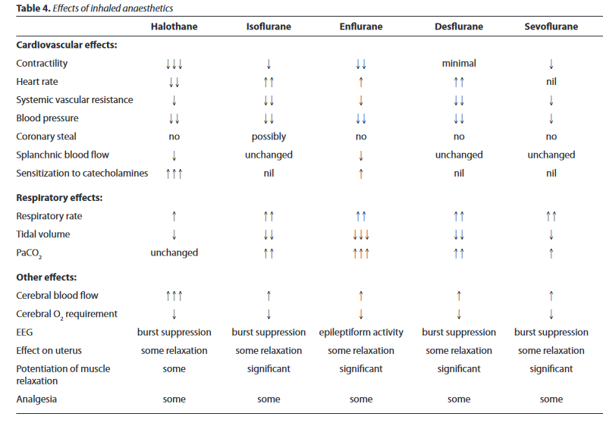

Slide 90
